Slide 1
JavaScript objects
Stettsen Olsen

Slide 2
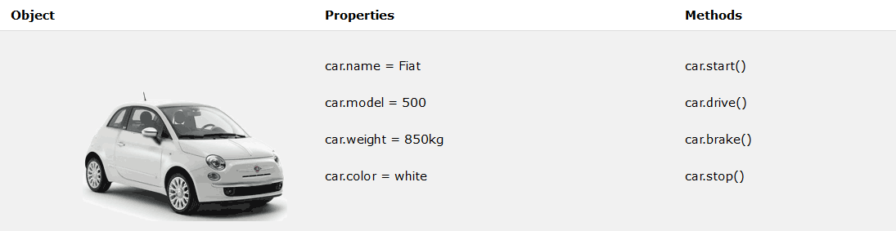
What is a Javascript object
A JavaScript Object is a container that houses variables and methods relevant to something. This is a custom variable type. A JavaScript object is essentially a class.
https://www.w3schools.com/Js/js_objects.asp

Slide 3

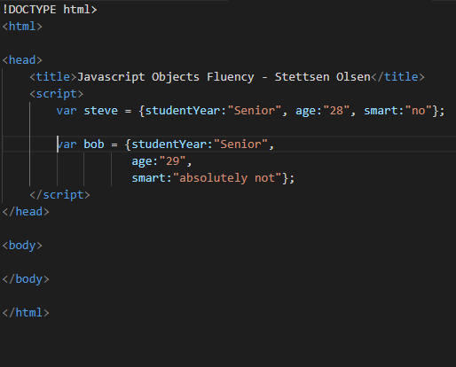
Simple Declaration
The first kind of declaration is a simple container of variables.
It’s a housing unit
JSON is used
These are called “name and value pairs”
When variables are stacked it looks more familiar. This is allowed.

Slide 4
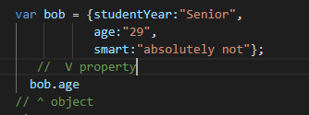
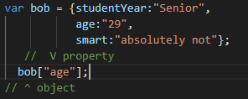
Accessing data
Like most OOP, the object is called and then the property
It can also be accessed like this
This may look familiar. This is how key and value arrays look and are accessed.

Slide 5
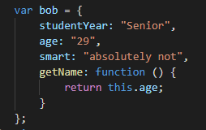
Object with methods
An object is still a variable
Functions are properties of that variable
When referencing variables it is important to use “this” as it refers to the “owner” or container of the variable and function
Accessing methods looks like this

Slide 6
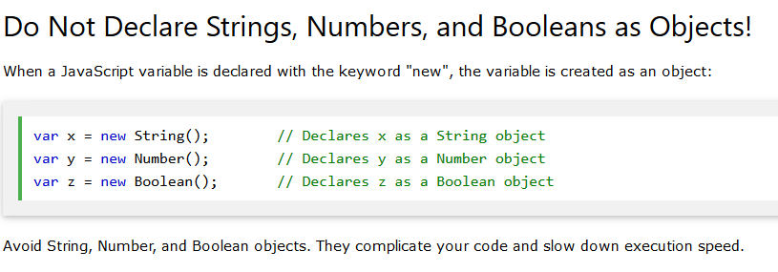
One more thing from w3schools.com

Slide 7
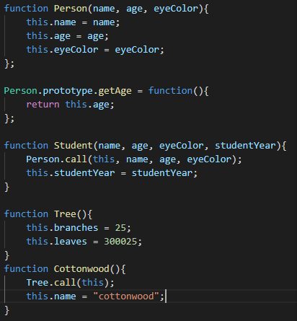
Inheritance
Classes are defined as functions
Methods are prototyped.
The call method is used to call the constructor of the parent class passing the current obect with “this” as the first parameter in addition to the ones already needed.

Slide 8
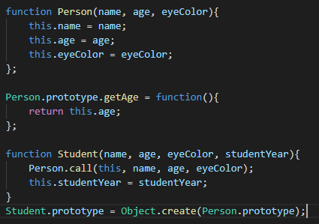
Inheritance 2
Only properties are transferred with the call method so one more method is needed to get all prototyped methods. This is the Object.create() method.
All prototyped methods are inherited

Slide 9

Inheritance 3
Lastly making the child class’ prototype equal to the parent’s mess up the constructor and sets it to the parent constructor
To fix this we need to set the constructor back to its own by using prototype, referencing the constructor, and then set it to the class.

Slide 10
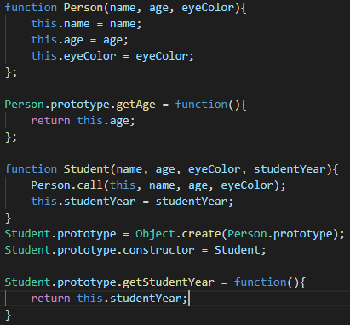
Inheritance 4
Now we can add methods to our child class as we did with the parent class

Slide 11

Instantiation
In this example we have to instances of a Person

